Slide 1

Supply Chain Optimization with AI
AI algorithms can optimize supply chains by improving demand forecasting, inventory management, and route planning, leading to increased efficiency and cost savings.
by Deep Green

Slide 2
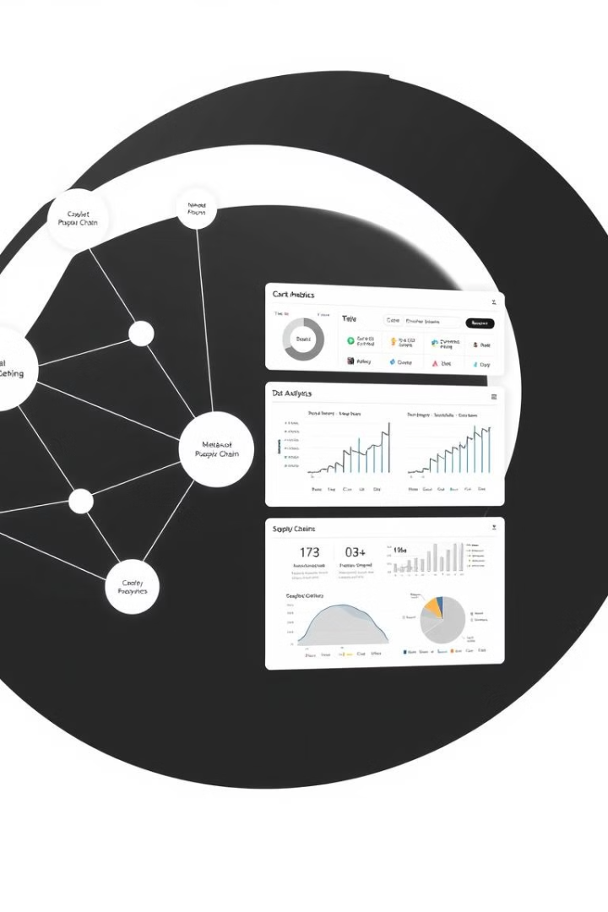
Problem Identification
1
Data Integrity
Ensuring data quality is crucial for accurate AI-driven supply chain optimization.
2
Real-Time Analysis
The need for real-time decision-making in dynamic supply chain environments.
3
Complex Networks
Controlling and optimizing intricate supply chain networks is a challenge.

Slide 3
Existing Solutions
Blue Yonder
C3 AI
Predictive Analytics
Scheduling tools for supply chain optimization.
Enterprise applications for supply chain visibility and efficiency.
Platforms enabling real-time supply chain decisions.

Slide 4

Strengths and Limitations
Strengths
Improved demand forecasting, efficient inventory management, and better transportation routes.
Limitations
Dependence on data quality, complexity of implementation, and potential high costs.

Slide 5

Data Requirements
Sales History
Shipment Tracking
Analyze past sales data to forecast future demand.
Use shipment data to improve transportation and logistics.
1
2
3
Inventory Levels
Monitor real-time inventory to optimize stock levels.

Slide 6




AI Methodologies
Machine Learning
For demand forecasting
Reinforcement Learning
For dynamic routing
Deep Learning
For anomaly detection and inventory control

Slide 7
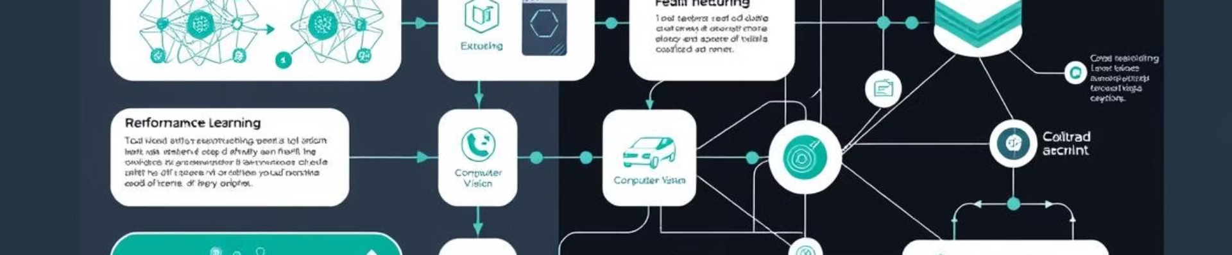



Model Architecture
Demand Forecasting
Dynamic Routing
Inventory Control
Neural networks for accurate predictions
Reinforcement learning for optimal routes
Convolutional layers for pattern recognition

Slide 8
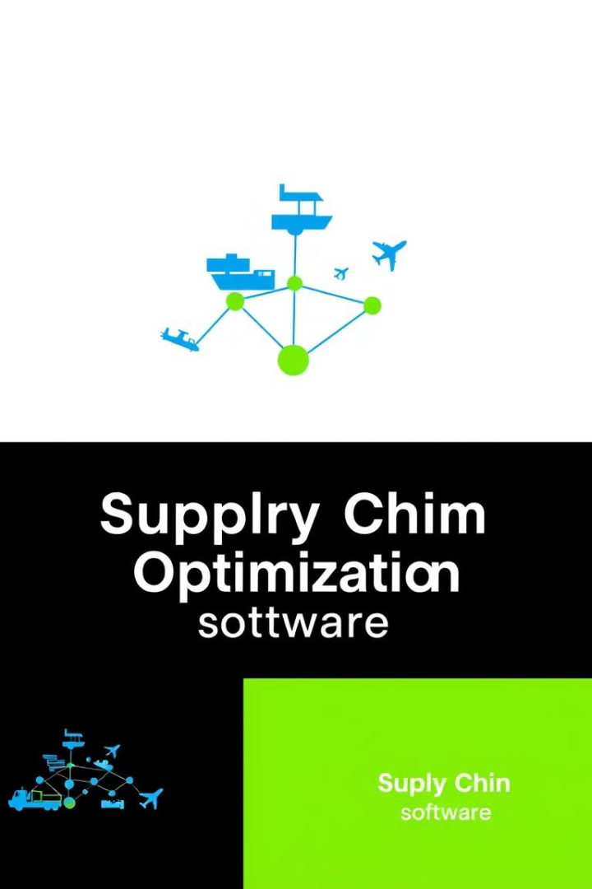
Tools and Frameworks
Blue Yonder
Scheduling tools
C3 AI
Enterprise applications
Google Cloud
AI solutions
IBM Watson
Predictive analytics

Slide 9

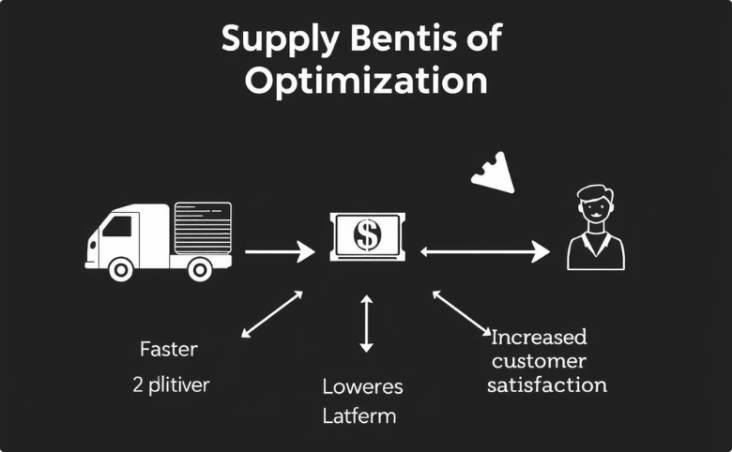
Innovation and Justification
Increased Accuracy and Efficiency
Tangible Benefits
AI-driven supply chain optimization improves forecasting, inventory management, and routing.
Justifies investment through cost savings, faster delivery, and enhanced customer experience.

Slide 10

Execution and Deployment
1
Define Goals
Clarify objectives and assumptions for the project.
2
Data Collection
Gather relevant data sources for analysis.
3
Deployment
Integrate the AI solution into real-world operations.

